Slide 1

Hedge Fund Replication
Performance Update and Strategy Change Proposal
Presentation to the PRIM Investment Committee
By Eric Nierenberg
September 21, 2015
Deborah B. Goldberg, Treasurer and Receiver General, Chair
Michael G. Trotsky, CFA, Executive Director and Chief Investment Officer

Slide 2
SEC Form 13F Replication
Hedge fund managers report their holdings to SEC quarterly (Form 13F) with 6-week lag
One can follow the hedge funds using 13F filings
For managers with low turnover, a follower’s strategy will overlap with the fund significantly
This strategy can potentially replicate the underlying funds’ returns

Slide 3
Current Strategy
Replicate activist managers ValueAct, Blue Harbour and Trian
Quarterly rebalance with 8-week lag
Long-only replication with no beta adjustment
Composite weightings are
ValueAct – 50%
Trian – 25%
Blue Harbour – 25%
Notes:
We propose to replicate ValueAct, Blue Harbour and Trian by forming a following strategy that rebalances quarterly, with a 2-month lag. This replication will be long-only, with no beta adjustment.

Slide 4
Performance Update
The strategy was launched on 9/30/2014
As of 8/31/2015
Replication strategy returned 7.45%
S&P 500 returned 1.65%
Realized an equity beta about 0.94
Realized an information ratio of 1.28 (appraisal ratio 1.32)
Compared to the actual activist funds (As of 6/30/2015*)
Replication returned 12.26%
Actual funds returned 10.75%
S&P 500 returned 6.25%
*Actual activist fund returns not yet available for July and August.

Slide 5
Tested More Activist Funds
Using the same method, tested replication performance for several new activist replication targets

Slide 6
Tested More Activist Funds
Closely monitored replication performance for activist funds already on our radar

Slide 7
Proposed Change I: Portfolio Weights
Add managers: Children’s, Starboard, Altai
Some managers exhibit higher risk levels than peers and more fluctuating risk levels over time
Therefore, allocating risk, instead of capital, is more appropriate
Proposed weights:
Portfolio will be rebalanced according to the new capital weights
Risk weights will be closely monitored
 | Risk Allocation | Capital Allocation
ValueAct | 50% | 55%
Childrens | 25% | 23%
StarBoard | 10% | 9%
Trian | 5% | 7%
Blue Harbour | 5% | 5%
Altai | 5% | 2%
 | 100% | 100%

Slide 8
Proposed Change II: Hedging
Current strategy is unhedged, realized a beta of 0.94.
The current PRIM Hedge Fund Benchmark has a beta of 0.25
We propose to implement an equity hedge
Bring down equity beta to match the benchmark
Increase exposure to pure activism and decrease exposure to overall equity market
Increase the diversification benefit to the PRIT portfolio

Slide 9
Proposed Change III: Increase Total Allocation
Since inception performance has been within expectation
Risk per dollar invested will be significantly reduced by hedging
We propose to increase the capital allocation to $200 million

Slide 10
Rebalancing Procedure
Prior to rebalance
45 days following each quarter end, gather position information from SEC website
Estimate portfolio risk characteristics based on new positions
Calculated portfolio weights based on risk estimates
Calculate the amount of S&P 500 futures needed to achieve the target beta of 0.25
Compare calculation results with SSgA’s calculation, and resolve discrepancies

Slide 11
Rebalancing Procedure
At rebalance
Long individual stocks
Short S&P 500 futures
SSgA executes trades
After rebalance
Monitor the portfolio equity beta level

Slide 12
END
Deborah B. Goldberg, Treasurer and Receiver General, Chair
Michael G. Trotsky, CFA, Executive Director and Chief Investment Officer

Slide 13
Proposed Strategy – Target Fund Selection
Target fund quality
Strong historical performance
Experienced investment team
Replication performance
Replication captures large portion of fund’s alpha
Explanatory power
Replication captures large portion of fund’s variation
Target funds are mostly long only
Notes:
We started the target fund selection with a list of prominent activist hedge funds. This initial list of funds needs to have strong historical performance and a highly experienced investment team.
Then we used historical 13F filings to form a hypothetical long-only replication portfolio with a 2-month lag. We compared the returns of the replication portfolio to the underlying fund, and measured the explanatory power by R-squared. R-squared is a statistical measure of how well the replication predicts the actual fund returns.
(R-Squared is calculated as the proportion of total variation of actual fund returns explained by the replication returns.)

Slide 14
Proposed Strategy – Rebalancing
Feb. 14th 2014, hedge funds file Form 13Fs to SEC based on their Dec. 31st 2013 holdings.
SSgA gathers the filings, calculates rebalance trades and executes trades on Feb 28th 2014, with a total lag of 2 months.
Portfolio weightings are based on estimates of Feb 28th closing market values.
The rebalance repeats quarterly with rebalance trades executed on month ends of February, May, August and November.

Slide 15
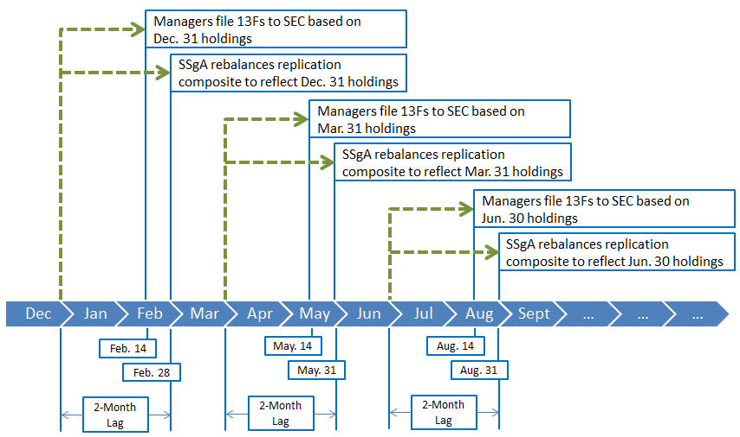
Proposed Strategy – Rebalancing
Notes:
To give a more specific example:
On Feb. 14th 2014, hedge funds file Form 13Fs to SEC based on their Dec. 31st 2013 holdings. We gather the filings, calculate rebalance trades and send those trades to the broker on Feb 28th 2014, with a total lag of 2 months. The rebalance repeats quarterly with rebalance trades executed on month ends of February, March, August and November.

Slide 16
Return Expectations & Characteristics
The composite has an equity beta of about 1
The composite historically shows small cap skew and an alpha of about 7% per year
A considerable amount of alpha could be due to selection bias, but we still expect the strategy to produce significant alpha beyond beta exposures
Due to the high equity beta, the composite will likely outperform HFRI Indices in bull markets and underperform HFRI Indices in bear markets
Alpha captured by replication will influence returns as well, offsetting beta draws in bear markets and adding on top of beta boosts in bull markets
Notes:
In backtesting, the replication composite showed an equity beta of about 1, some small cap skew, and an alpha of about 7% per year.
A considerable amount of alpha could be due to selection bias, but we still expect the strategy to produce significant alpha beyond beta exposures.
Due to the high equity beta, the composite will likely outperform HFRI Indices in bull markets and underperform HFRI Indices in bear markets.
Alpha captured by replication will influence returns as well, offsetting beta draws in bear markets and adding on top of beta boosts in bull markets.
Therefore, we suggest evaluating the successfulness of the replication composite by comparing it to the beta adjusted returns of a composite of the underlying funds.

Slide 17
Underlying Fund Profiles
ValueAct is a concentrated activist fund that focuses on 10 to 18 core investments and 2 to 5 “farm team” positions, predominately in U.S. equities.
Trian is a concentrated activist fund that focuses on “operational” activism. The fund invests in larger cap names. They tend to focus on consumer products and services, including food and beverage companies, due to operational expertise of the team.
Blue Harbour Active Ownership Partners is a long only concentrated activist fund that focuses on 7 to 10 core positions and 5 to 10 “farm team” positions, predominately in small to midcap U.S. equities. They employ a “friendly” activism approach that has a positive reputation with company management.
 | ValueAct | Trian | Blue Harbour
Inception Date | 2000 | 2005 | 2004
Firm Assets | $9.2 Billion (2013) | $7.5 Billion (2013) | $1.8 Billion (2013)
Staffing (Total/Investment) | 29/12 | 45/15 | 17/8
Principal Partners | Jeff Ubben | Nelson Peltz Peter May Edward Garden | Clifton Robbins

Slide 19
Example of Composite Holdings
Asset Name | Sector | GICS Industry | Weight | Fund
Valeant Pharmaceuticals | Health Care | Pharmaceuticals | 10.44% | ValueAct
Microsoft | Technology | Software | 9.90% | ValueAct
Motorola Solutions | Technology | Communications Equipment | 7.39% | ValueAct
Adobe Systems | Technology | Software | 6.71% | ValueAct
Mondelez International | Cons. Staples | Food Products | 5.89% | Trian
Rockwell Collins | Industrials | Aerospace & Defense | 4.18% | ValueAct
Pepsico | Cons. Staples | Beverages | 4.13% | Trian
Akamai Technologies | Technology | Internet Software & Services | 3.49% | Blue Harbour
CBRE Group | Financials | Real Estate Management & Development | 3.47% | ValueAct
Wendy's | Cons. Disc. | Hotels Restaurants & Leisure | 3.32% | Trian
Ingersoll-Rand | Industrials | Machinery | 3.06% | Trian
CACI International | Technology | IT Services | 3.03% | Blue Harbour
Willis Group | Financials | Insurance | 2.90% | ValueAct
Progressive Waste Solutions | Industrials | Commercial Services & Supplies | 2.76% | Blue Harbour
Legg Mason | Financials | Capital Markets | 2.47% | Trian
Chicos FAS | Cons. Disc. | Specialty Retail | 2.37% | Blue Harbour
Family Dollar Stores | Cons. Disc. | Multiline Retail | 2.29% | Trian
Allscripts | Health Care | Health Care Technology | 2.28% | Blue Harbour
Brocade Communications | Technology | Communications Equipment | 2.16% | Blue Harbour
Globe Specialty Metals | Materials | Metals & Mining | 2.15% | Blue Harbour
Source: Company 13F Filings, as of December 31, 2013

Slide 20
Example of Composite Holdings
Asset Name | Sector | GICS Industry | Weight | Fund
Nabors Industries | Energy | Energy Equipment & Services | 2.13% | Blue Harbour
Allison Transmission | Cons. Disc. | Auto Components | 2.07% | ValueAct
Devry Education Group | Cons. Disc. | Diversified Consumer Services | 1.70% | Blue Harbour
DuPont | Materials | Chemicals | 1.61% | Trian
Micros Systems | Technology | Software | 1.44% | ValueAct
Lazard | Financials | Capital Markets | 1.26% | Trian
MSCI | Financials | Diversified Financial Services | 1.26% | ValueAct
Allegion | Industrials | Building Products | 0.91% | Trian
URS | Industrials | Construction & Engineering | 0.79% | Blue Harbour
Babcock & Wilcox | Industrials | Electrical Equipment | 0.56% | Blue Harbour
Dominion Diamond | Materials | Metals & Mining | 0.51% | Blue Harbour
Entegris | Technology | Semiconductors & Semiconductor Equipment | 0.44% | Blue Harbour
Ishares Russell 2000 ETF | N/A | N/A | 0.42% | Blue Harbour
Dresser-Rand Group | Energy | Energy Equipment & Services | 0.14% | ValueAct
Dice | Technology | Internet Software & Services | 0.11% | Blue Harbour
Kar Auction Services | Industrials | Commercial Services & Supplies | 0.10% | ValueAct
GNC | Cons. Disc. | Specialty Retail | 0.07% | Trian
Employers Holdings | Financials | Insurance | 0.06% | Blue Harbour
Interxion | Technology | IT Services | 0.04% | Blue Harbour
Tiffany | Cons. Disc. | Specialty Retail | 0.00% | Trian
Source: Company 13F Filings, as of December 31, 2013

